Slide 1

Online to-do list
Abdelhameed-Karim-Michael

Slide 2
Outline
Introduction
Topology
Implementation
Final Application

Slide 3
Web Service
Is any piece of software that makes itself available over the internet and uses a standardized messaging system.
Modern web browsers and servers implement all features in REST.

Slide 4
REST REpresentational State Transfer
Rest is a software architecture style
The Uniform interface is implemented by HTTP protocol
REST is characterized by:
Stateless Server
Uniform Interface
Resource is send in the message Body

Slide 5
REST Features
Resource: Any named concept.
Resource identification: URI.
Resource representation: Document, data.
Messages: HTTP messages.
Control data in messages: HTTP method (GET, POST, DELETE).
Resource in message: Data in message body.

Slide 6
Components
MySQL database
JavaScript server
Python client

Slide 7

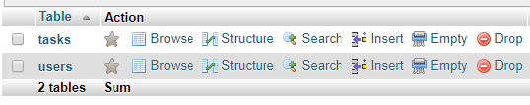
MySQL Database

Slide 8
MySQL Database
Users Table
User ID
User Unique Name
Tasks Table
Unique ID
Task Name
Description
Due Date
Task Owner

Slide 9
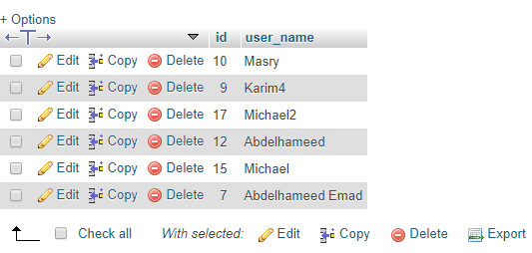
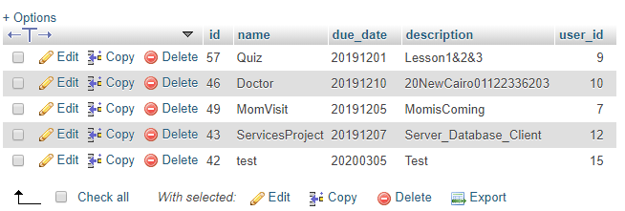
MySQL Database

Slide 10


Server
Back End

Slide 11
Server
Create or Add Tasks
Delete or Remove Tasks
Sign Up and Authentication
Display all Related Tasks
Database Integrity

Slide 12
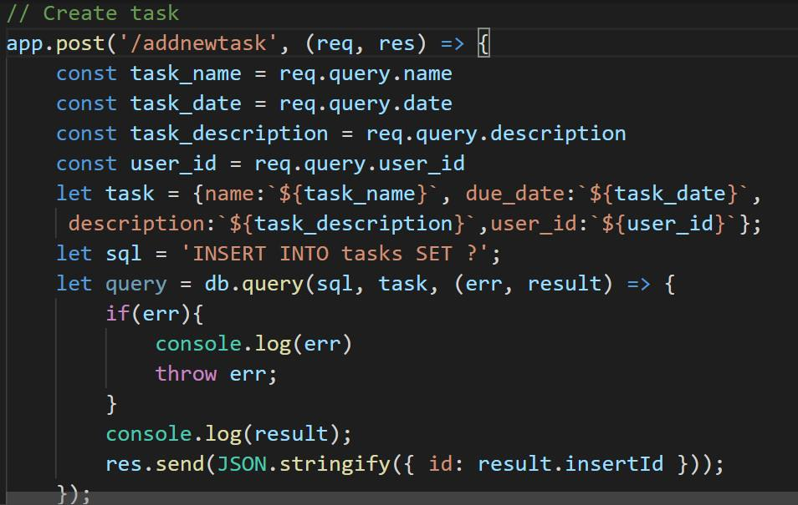
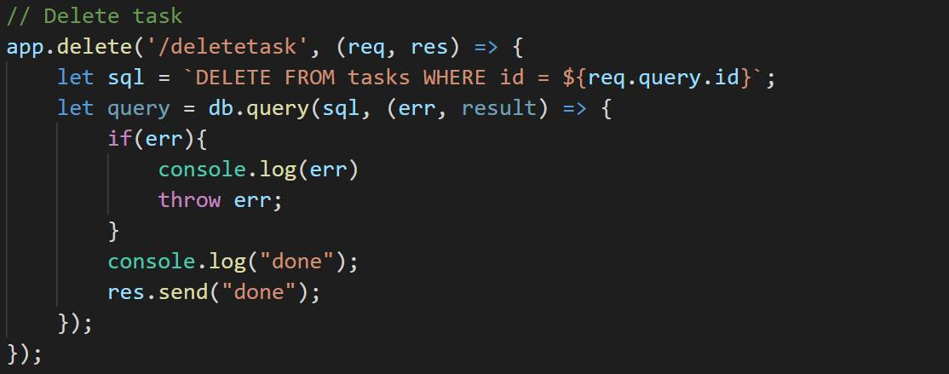
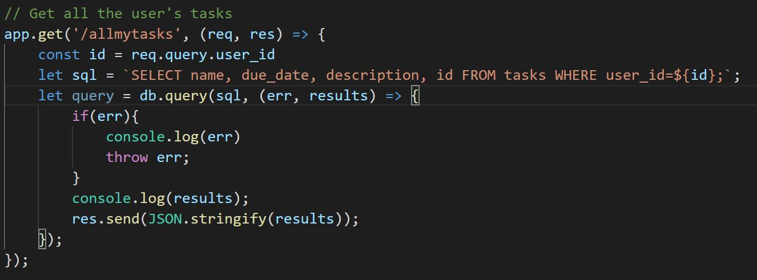
Server

Slide 13

Python Client
Python: Tkinter

Slide 14
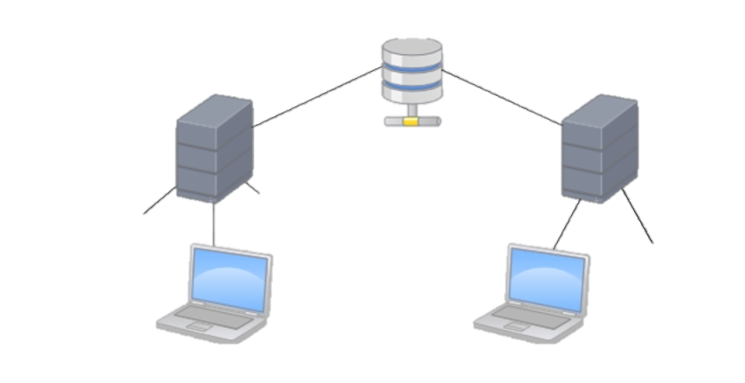
Python Client
Database
Servers
Clients

Slide 15
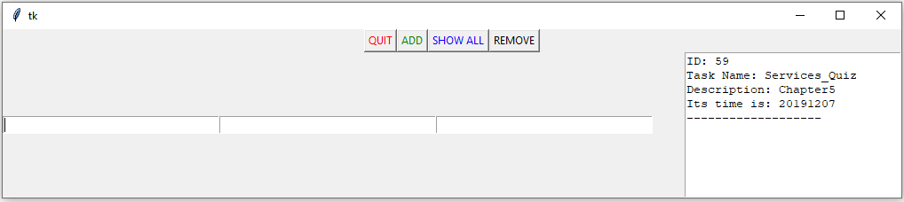
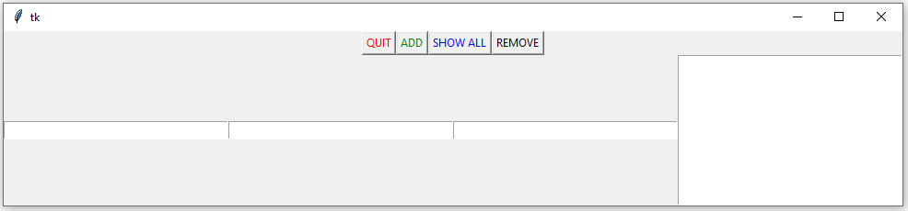
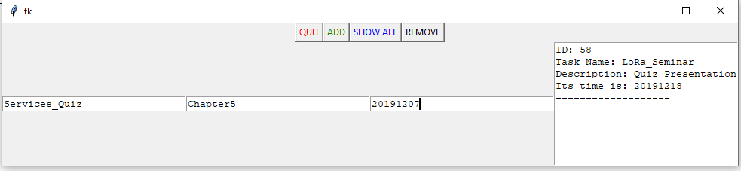
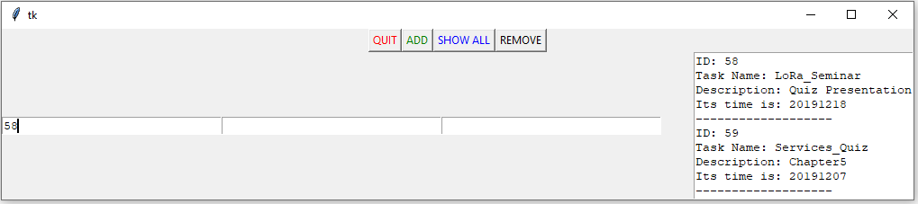
Python Client

Slide 16
Server & Client
REST ???
http://127.0.0.1:3000/signup?username=Michael
http://127.0.0.1:3000/allmytasks?user_id=8
http://127.0.0.1:3000/deletetask?id=2
http://127.0.0.1:3000/addnewtask?name=servicesHW&date=20191210&description=homework33&user_id=8

